Slide 1
The Digestive System
AEHBY ATAR Human Biology

Slide 2
Review
What is lymph? What does it contain, where is it found and how is it formed?
Explain why the veins, heart and lymphatic vessels need valves but arteries and capillaries do not.
Briefly explain the role of lymphocytes in immunity.
List the factors which assist alveolar gas exchange.
Sketch and explain the enzyme function vs pH graph.

Slide 3
Learning Intentions
The supply of nutrients in a form that can be used in cells is facilitated by the structure and function of the digestive system at the cell, tissue and organ levels.

Slide 4
Success Criteria
Label and describe the function of the organs of the digestive system.
List enzymes of the digestive system.
Explain the role of villi and microvilli.
Compare the absorption mechanism of glucose and lipids.

Slide 5
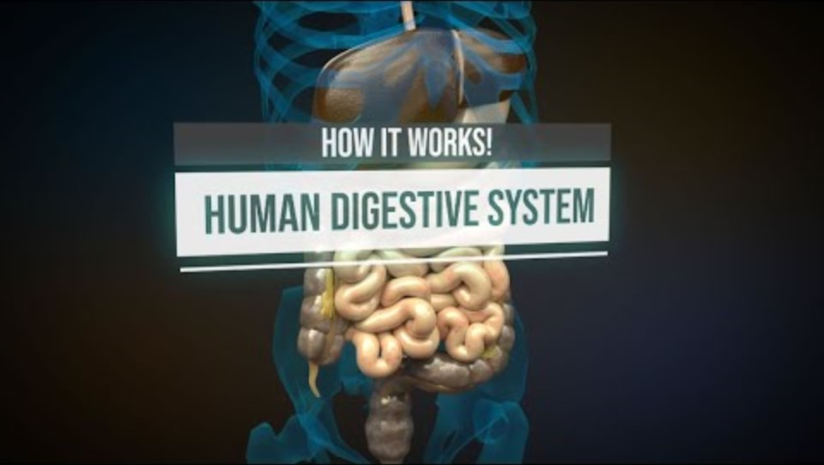

Slide 6
Questions
Describe the role of muscle in the oesophageal and gastric walls.
List the enzymes of the digestive system, what they catalyse and their ideal pH.
Describe the roles of hydrochloric acid in the stomach.
Describe the structure, location and function of villi.
What is the purpose of microvilli?
Explain why glucose can be freely absorbed into the blood stream, but fatty acids must be transported in lymph.
Why does the large intestine not have villi?

Slide 7
Success Criteria
Label and describe the function of the organs of the digestive system.
List enzymes of the digestive system.
Explain the role of villi and microvilli.
Compare the absorption mechanism of glucose and lipids.

